Slide 1
LPC2148 Timer/Counter
LPC2148 Timer/Counter | ARM7-LPC2148 (electronicwings.com)

Slide 2
Timer
specific type of clock which is used to measure the time intervals.
It provides/measures the time interval by counting the input clocks
Counter
similar to Timers but works in a reverse manner to the timers.
It counts the external events or we can say external clock ticks.
It is mostly used to measure frequency from the counts of clock ticks.
Timer and Counter functionally same, except timer uses the peripheral clock (PCLK) for its timing, while counter uses an external source
A counter is called a capture timer – used to count external event via capture input

Slide 3
LPC2148 Timer has input of peripheral clock (PCLK) or an external clock. It counts the clock from either of these clock sources for its operation.
LPC2148 Timer/Counter can generate an interrupt signal at specified time value.
LPC2148 has match registers that contain count value which is continuously compared with the value of the Timer register. When the value in the Timer register matches the value in the match register, specific action (timer reset, or timer stop, or generate an interrupt) is taken.
LPC2148 has capture registers which can be used to capture the timer value on a specific external event on capture pins.

Slide 4
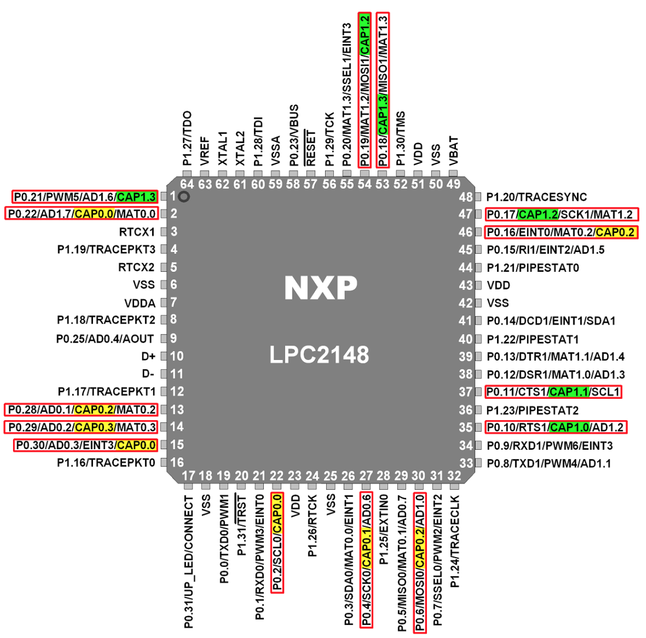
Timer Capture Mode
LPC2148 Timer includes input capture feature, using which we can capture/trap the timer counter value on events like rising edge (positive going) and falling edge (negative going). With this function, we can measure frequency, pulse width, duty cycle of the input signal
The Capture Control Register decides which event is to be recorded (e.g. rising/falling edge or both) and whether an interrupt is to be generated.
On each capture event on a capture pin, corresponding capture register gets copied with the TC (Timer Counter) value

Slide 5
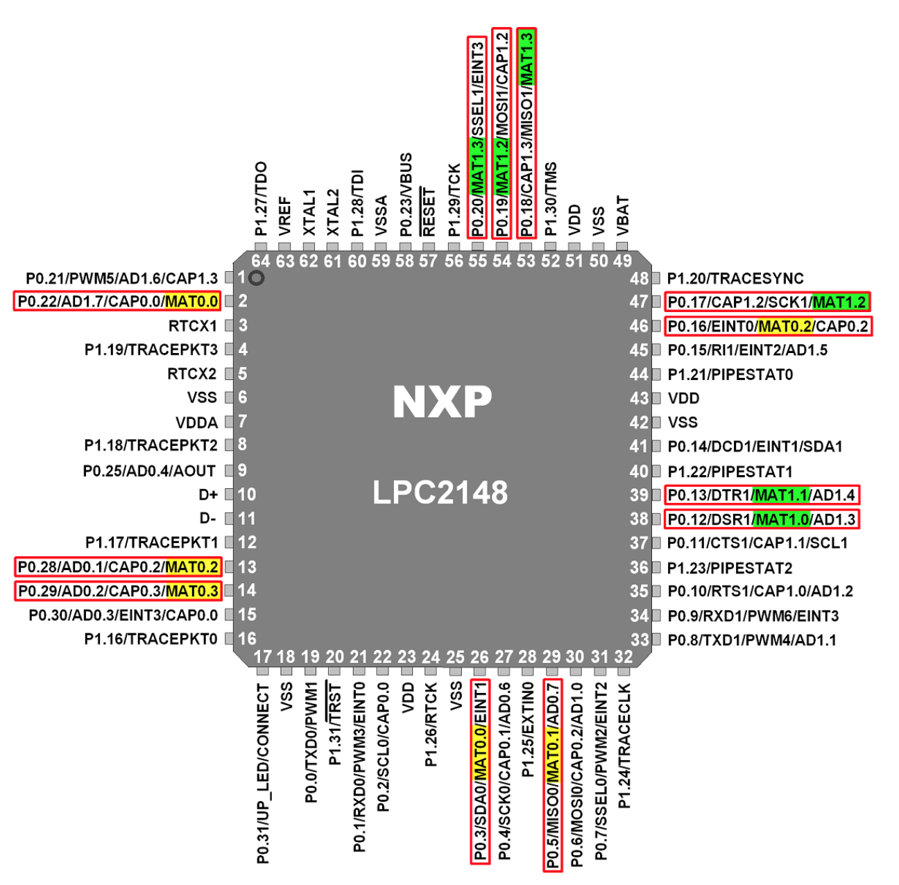
Control Timer and output - Match
This 32-bit value is written in Match Register (MR) and continuously compared with 32-bit Timer Counter (TC) value.
When this match register value and Timer Counter (TC) value are equal, we can reset/stop Timer Counter (TC) and can generate an interrupt.
Timer counter (TC) counts the input PCLK (Peripheral Clock) i.e. one count of Timer Counter (TC) is equal to the one cycle of PCLK
We can also extend one count of Timer Counter by several PCLK clocks using the Prescale Counter (PC). Prescale Register (PR) is used to set the maximum value for PC.
We can make specific pins (also called as match pins) of LPC2148 High/Low/Toggle on the event match occurrence.

Slide 6
2 - 32-bit Timers – Timer0/Counter0 & Timer1/Counter1
Special Function Registers for Timer 0
Timer Count Register- T0TC
32-bit registers
Range of counting from 0 to 0xFFFFFFFF and then wraps back to the 0x00000000
This register is incremented on every tick of the clock ( i.e. PCLK), if the prescale counter is made 0
Timer Control Register- T0TCR
8-bit register
Only lowest 2 bits are used
Bit 0- Enable bit
1 : counter is enabled and starts. T0TC register is incremented for every clock cycle of PCLK
Bit 1- Reset bit
1: the counter reset on the next positive edge of PCLK

Slide 7
Match Registers (MR0 to MR3)
4 -32-bit match registers are available : MR0 to MR3
One match register may be sufficient for one timer operation
Loading number into the match register
Match Control Register – T0MCR
16-bit register, used to specify an event to occur when match occurs
Bit 0 – I : When 1 – an interrupt is activated when match occurs
When 0 – the interrupt is disabled
Bit 1 – R : When 1 – timer count register (T0TC) is reset when match occurs
When 0 – this feature is disabled
Bit 2 – S : When 1 – time count (T0TC) and the pre-scale counter will be stopped when match occurs, also Enable bit of the T0TCR is made 0

Slide 8
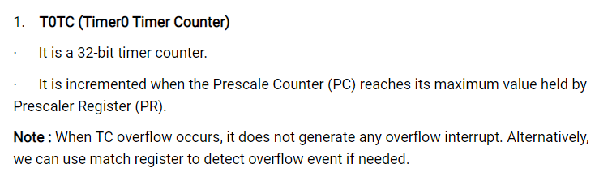

Slide 9
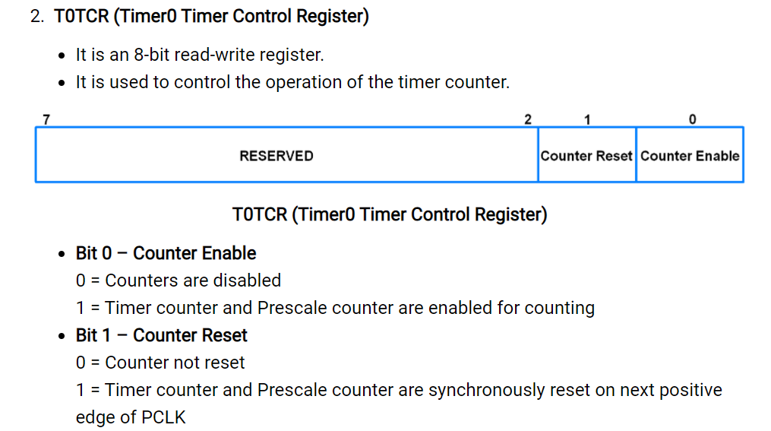

Slide 10
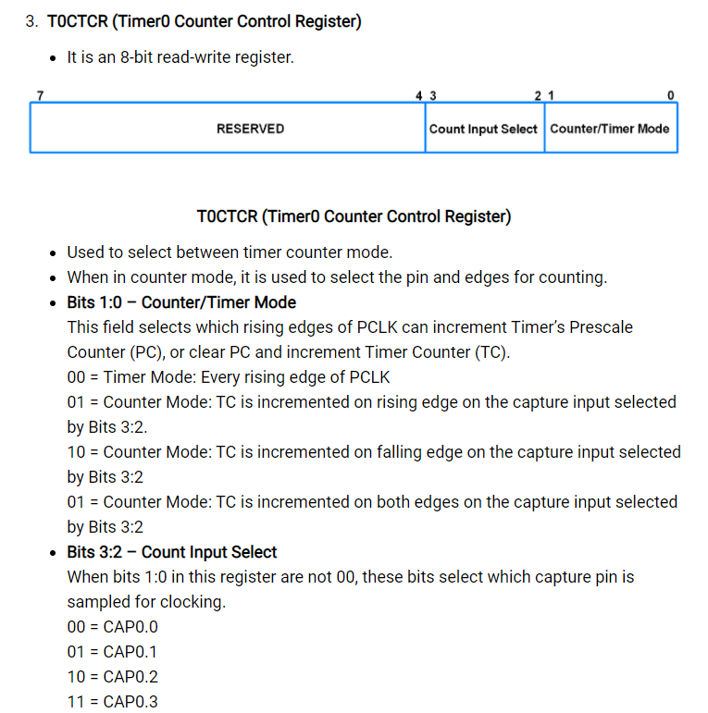

Slide 11
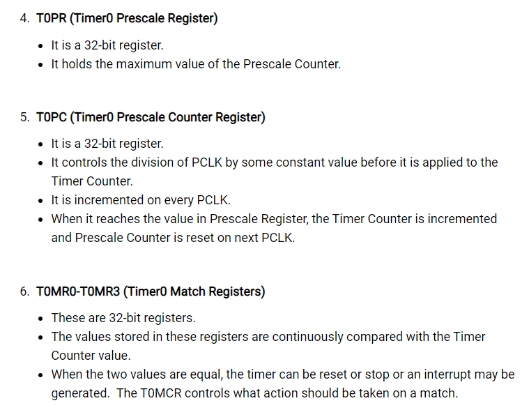

Slide 12
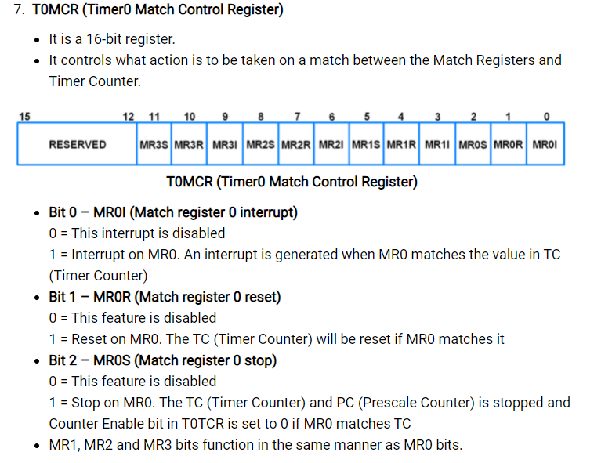

Slide 13
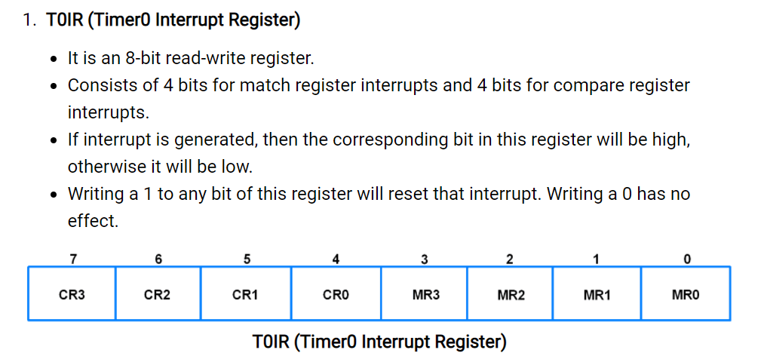

Slide 14
Simplified Block Diagram of Timer Unit
Match Control Register
Match Register
Control
Stop
=
Reset
Timer Count Register
Timer Control Register
Pre scaler
PCLK

Slide 15
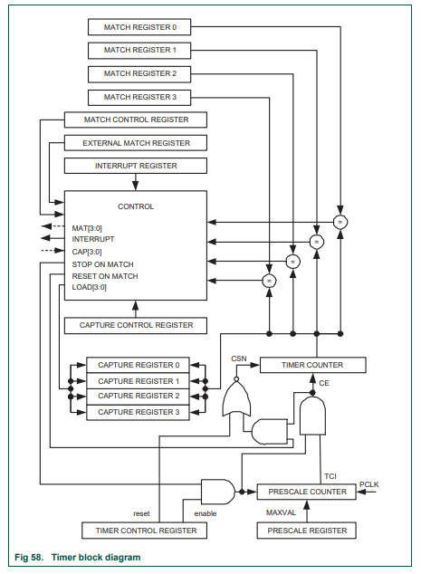

Slide 16
Timer Operation
Load a number in a match register
Start the timer by enabling the ‘E’ bit of T0TCR
The timer count register (T0TC) starts incrementing for every tick of the peripheral clock (PCLK) (no pre-scaling is done)
When the content of the T0TC equals the value in the match register, timing is said to have occurred
One of many possibilities can be made to occur when this happens
The possibilities are to reset the timer count register, stop the timer, or generate an interrupts. This setting is done in the T0MCR register

Slide 17
Calculation of Timer Output Frequency
Crystal Frequency = 60Mhz
PCLK = 60 MHz/4 = 15MHz
T=0.067us
If the match value =0xFF (256 periods of PCLK)
Timer creates delay of 256x 0.067us = 17.075us, this delay is half the period of the square wave.
The period of the signal is 2x17.075us =34us

Slide 18
Using Prescaler
To get lower frequency output – facility of using prescale counter
2 register with prescaling – Prescale counter, prescale register
Prescale counter increments for every PCLK, when it counts up to the value of the prescale counter (T0PR), it allows the timer counter (T0TC) to increment its value by 1
This causes T0TC to increment on every PCLK when PR=0, increment on every 2 PCLK when PR=1, increment on every 3 PCLK when PR=2, so on
In effect load a number to T0PR, which will cause the output frequency to get divided

Slide 19
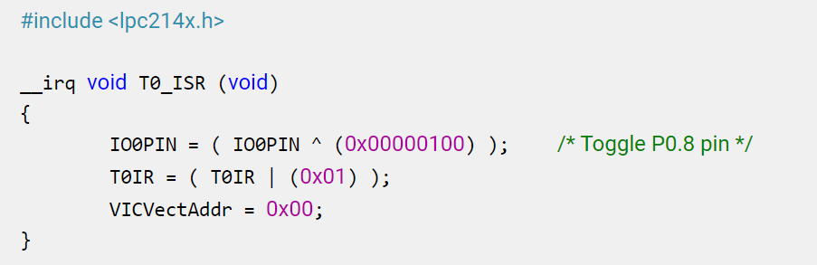
Program

Slide 20
int main (void)
{
VPBDIV = 0x00000002; /* For Pclk = 30MHz */ /* We have configured Cclk=60MHz. Above instruction makes
Pclk = Cclk/2 = 30MHz */
PINSEL0 = PINSEL0 | 0x00000020; /* Configure P0.2 as Capture 0.0 */
IO0DIR = ( IO0DIR | (0x00000100) ); /* 8 P0.8-P0.15 as output pins for LED port */
IO0PIN = IO0PIN | 0x00000100; /* Writing 1 to LED pin P0.8 */
VICVectAddr0 = (unsigned) T0_ISR; /* T0 ISR Address */
VICVectCntl0 = 0x00000024; /* Enable T0 IRQ slot */
VICIntEnable = 0x00000010; /* Enable T0 interrupt */
VICIntSelect = 0x00000000; /* T0 configured as IRQ */
T0TCR = 0x02; /* Reset TC and PR */
T0CTCR = 0x00; /* Timer mode, increment on every rising edge */
T0PR = 0x1D; /* Load Pre-Scalar counter with 29 (0 to 29 = 30), so that timer counts every 1usec */
T0MR0 = 100000; /* Load timer counter for 100msec delay, 1usec*1000*100 */
T0MCR = 0x0003; /* Interrupt generate on match and reset timer */
T0TCR = 0x01; /* Enable timer */
while (1); }

Slide 21
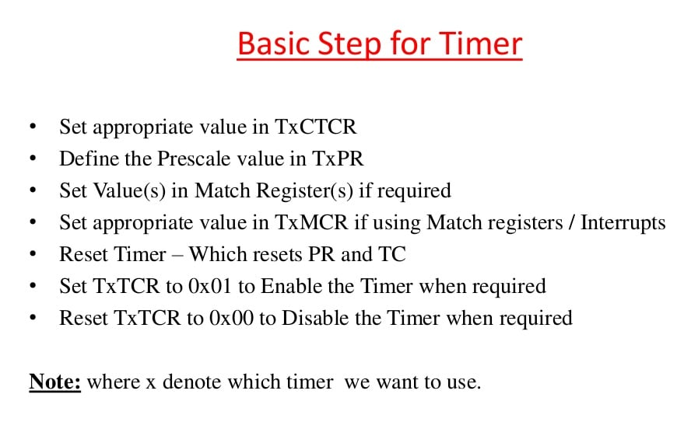

Slide 22
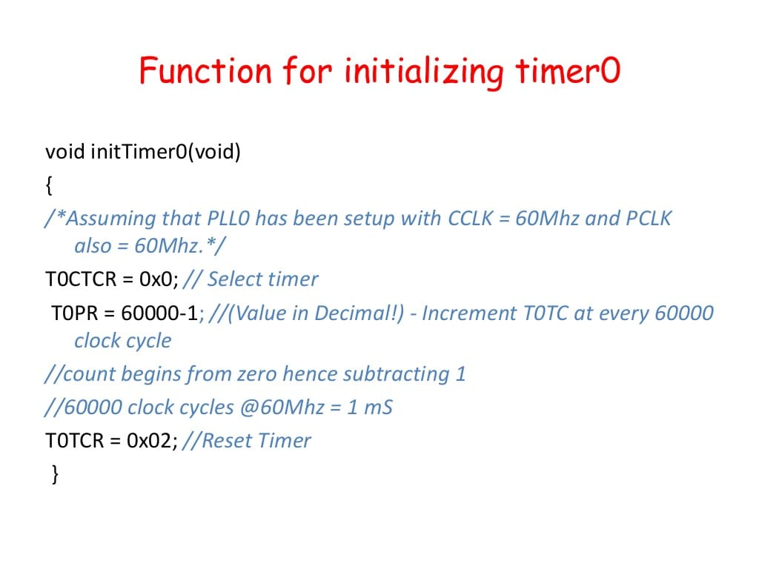

Slide 23
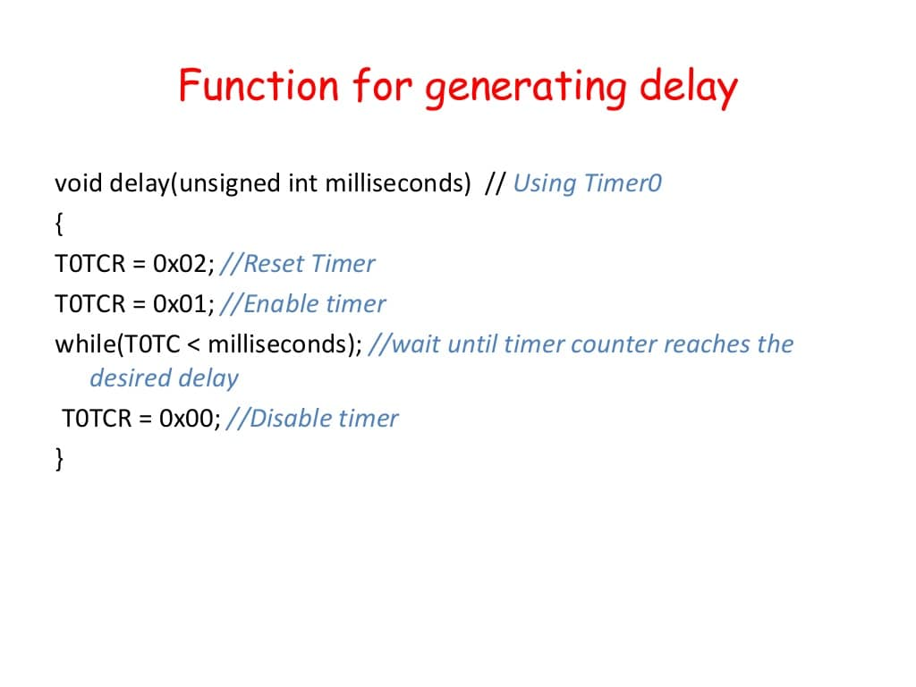

Slide 24
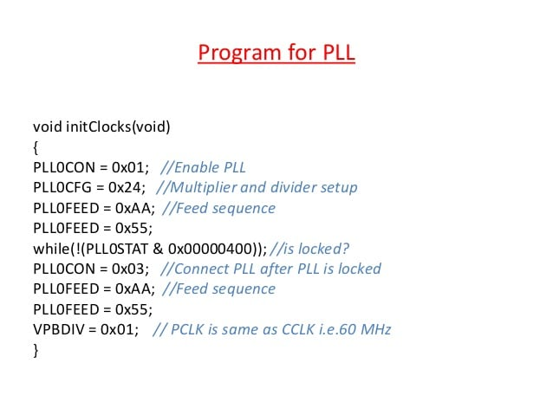

Slide 25
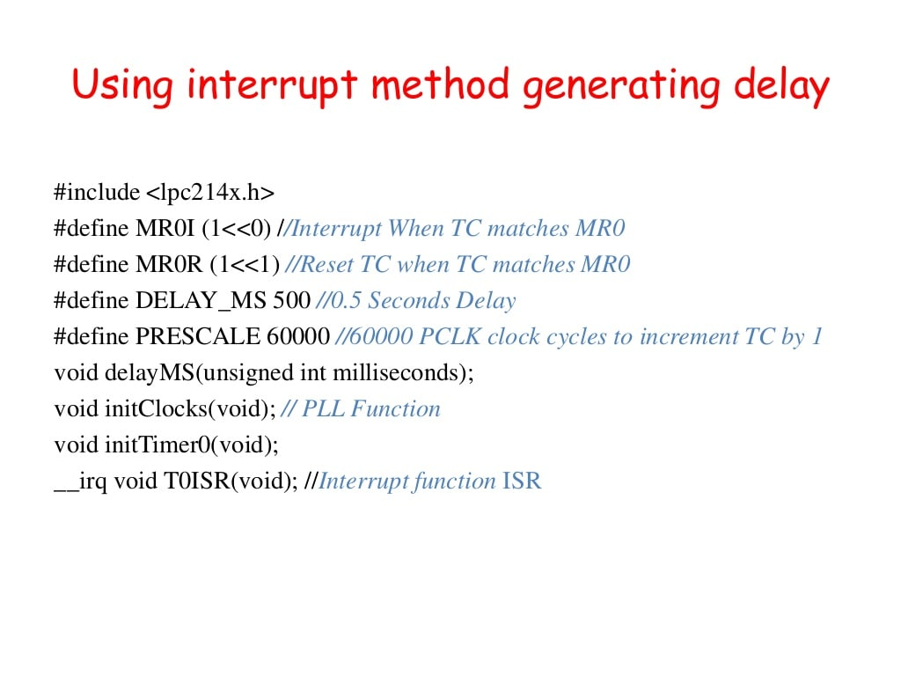

Slide 26
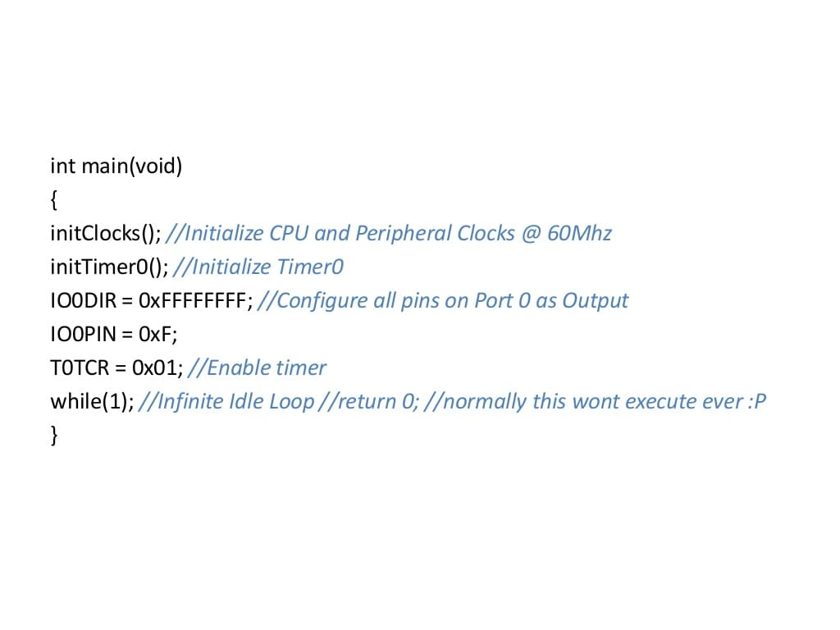

Slide 27
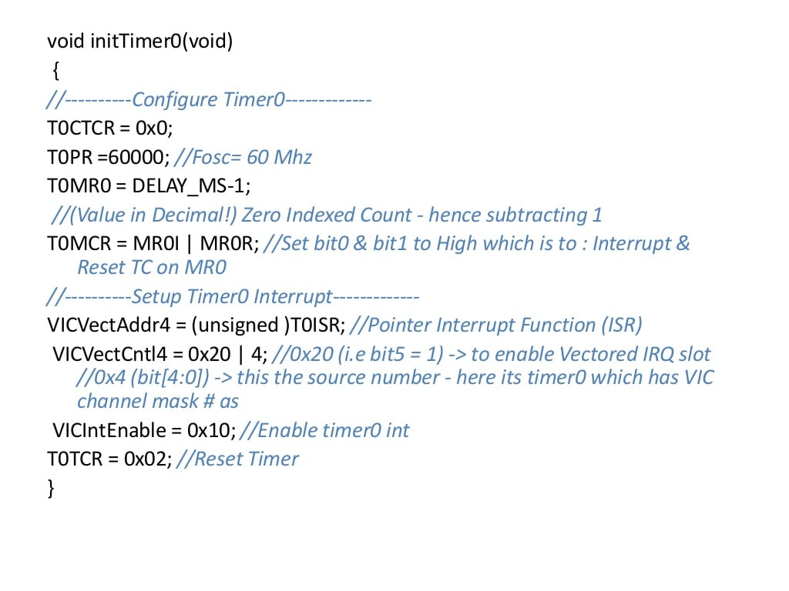

Slide 28
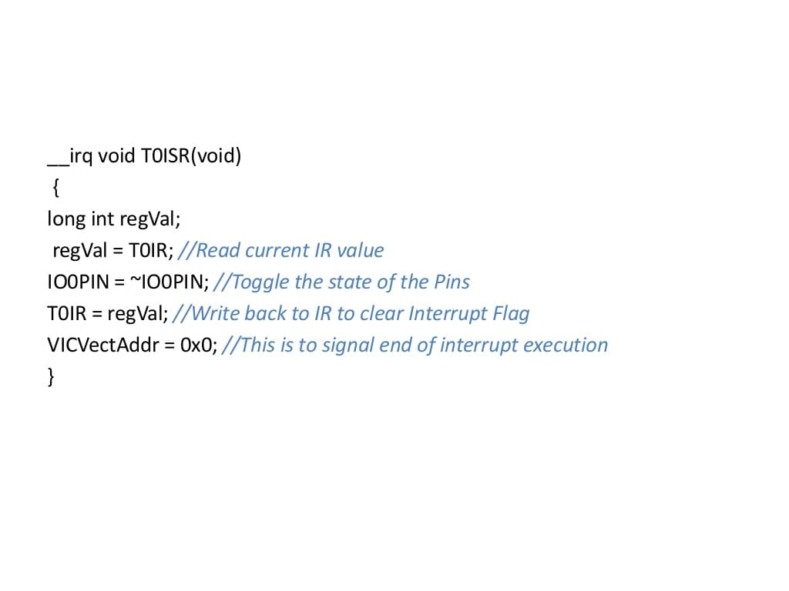

Slide 29
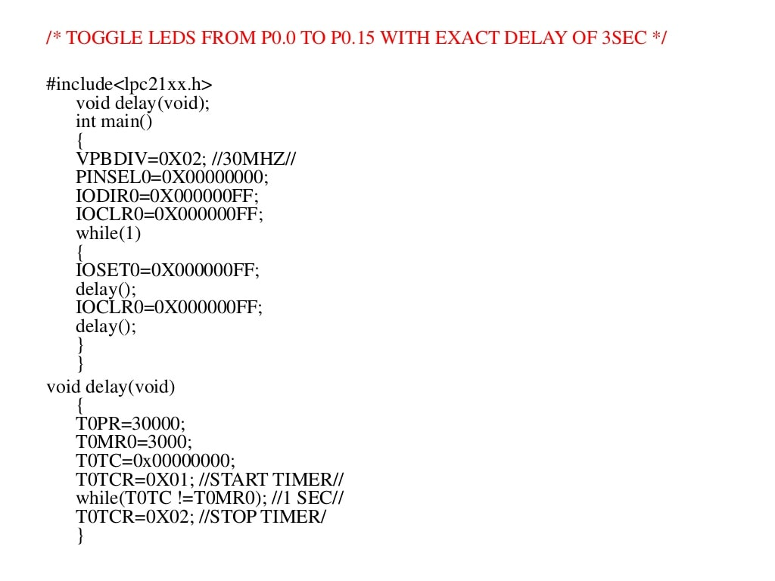

Slide 30
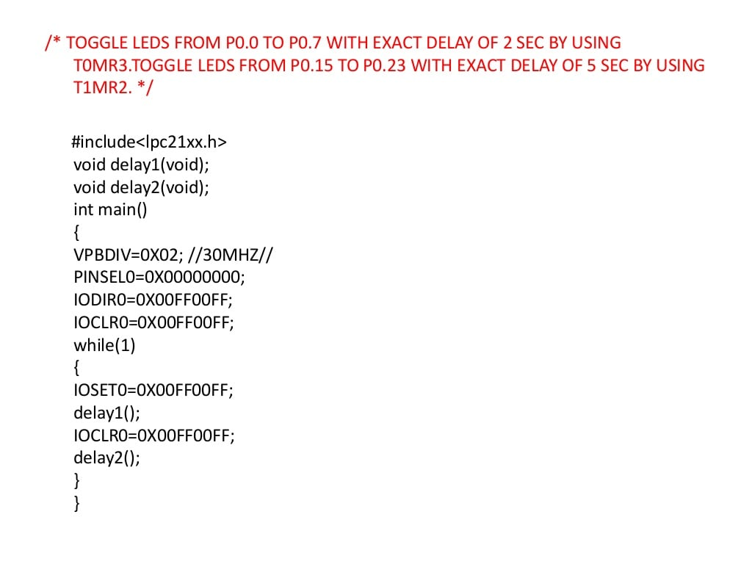

Slide 31
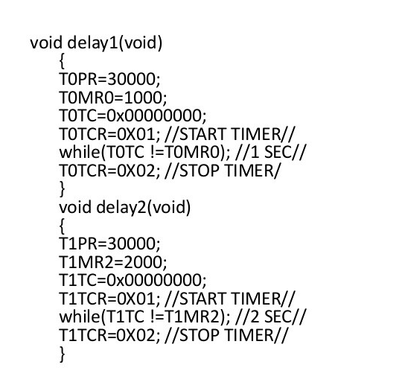

Slide 32
Thank You

